Slide 1
Tools? Technology? Beings?
Starting points for artists

Slide 2
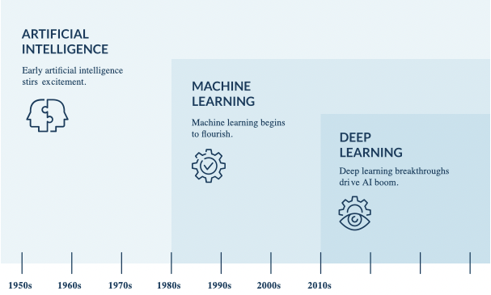

Slide 3
„just a tool“?

Slide 4
Personalization
Prediction
Content Extraction
Applications of AI
Data Compression
Content Generation
Content Improvement
Content Analysis

Slide 5
Personalization
Prediction
Content Extraction
Applications of AI
Data Compression
Content Generation
Text to Image
Text to Video
Chatbotss
Content Improvement
Content Analysis
Code Writing

Slide 6
Personalization
Prediction
Tracking
Segmentation
Content Extraction
Salient Object Detection
Applications of AI
Data Compression
Content Generation
Text to Image
Text to Video
Chatbotss
Content Improvement
Content Analysis
Code Writing

Slide 7
Personalization
Prediction
Tracking
Segmentation
Content Extraction
Salient Object Detection
Applications of AI
Data Compression
Content Generation
Text to Image
Text to Video
Chatbotss
Content Improvement
Content Analysis
Code Writing
Intent Detection
Entity detection
Sentiment Analysis
Automatic Annotation

Slide 8
Personalization
Prediction
Tracking
Segmentation
Content Extraction
Salient Object Detection
Applications of AI
Data Compression
Content Generation
Text to Image
Text to Video
Chatbotss
Content Improvement
Content Analysis
Code Writing
Debugging
Intent Detection
Text Correction
Aesthetic improvement
Entity detection
Restauration
Sentiment Analysis
Colorization
Automatic Annotation

Slide 9
Recommender Systems
Personalization
Prediction
Tracking
Personalized Chatbots
Segmentation
Content Extraction
Salient Object Detection
Applications of AI
Data Compression
Content Generation
Text to Image
Text to Video
Chatbotss
Content Improvement
Content Analysis
Code Writing
Debugging
Intent Detection
Text Correction
Aesthetic improvement
Entity detection
Restauration
Sentiment Analysis
Colorization
Automatic Annotation

Slide 10
Recommender Systems
Digital Twins
Personalization
Prediction
Tracking
Personalized Chatbots
Segmentation
Content Extraction
Salient Object Detection
Applications of AI
Data Compression
Content Generation
Text to Image
Text to Video
Chatbotss
Content Improvement
Content Analysis
Code Writing
Debugging
Intent Detection
Text Correction
Aesthetic improvement
Entity detection
Restauration
Sentiment Analysis
Colorization
Automatic Annotation

Slide 11
Is it a technology?

Slide 12
Environmental Problems
Vulnerable World Risks
Mass unemployment
War at machine time
New Enlightment
Political/societal Issues on AI
Proprietary Platforms
Manipulation of political opinions
Total surveillance

Slide 13
Energy consumption
Water consumption
Environmental Problems
Vulnerable World Risks
Mass unemployment
War at machine time
New Enlightment
Political/societal Issues on AI
Proprietary Platforms
Manipulation of political opinions
Total surveillance

Slide 14
Energy consumption
Water consumption
New unforeseen Inventions that cannot be controlled
Environmental Problems
Vulnerable World Risks
Mass unemployment
War at machine time
New Enlightment
Political/societal Issues on AI
Proprietary Platforms
Manipulation of political opinions
Total surveillance

Slide 15
Energy consumption
Water consumption
New unforeseen Inventions that cannot be controlled
Environmental Problems
Vulnerable World Risks
Only bullshit jobs
Mass unemployment
War at machine time
New Enlightment
Political/societal Issues on AI
Proprietary Platforms
Manipulation of political opinions
Total surveillance

Slide 16
Energy consumption
Water consumption
New unforeseen Inventions that cannot be controlled
Environmental Problems
Vulnerable World Risks
Only bullshit jobs
Mass unemployment
War at machine time
Expansion of the humon ratio
New Enlightment
Political/societal Issues on AI
Proprietary Platforms
The end of gatekeeping
Manipulation of political opinions
Total surveillance

Slide 17
Energy consumption
Water consumption
New unforeseen Inventions that cannot be controlled
Environmental Problems
Vulnerable World Risks
Only bullshit jobs
Mass unemployment
War at machine time
Expansion of the humon ratio
New Enlightment
Political/societal Issues on AI
Proprietary Platforms
The end of gatekeeping
Antidemocratic tendencies
Manipulation of political opinions
Total surveillance
Reality Apathy
Lack of „Zivilcourage“ and organized Opposition

Slide 18
Energy consumption
Water consumption
New unforeseen Inventions that cannot be controlled
Environmental Problems
Vulnerable World Risks
Only bullshit jobs
Mass unemployment
War at machine time
Expansion of the humon ratio
New Enlightment
Political/societal Issues on AI
Proprietary Platforms
The end of gatekeeping
Antidemocratic tendencies
Manipulation of political opinions
Total surveillance
Reality Apathy
New Forms of Totalitarism
Suppression of Minorities
Lack of „Zivilcourage“ and organized Opposition
Surveillance of Political Enemies
Unforgiving jurisdiction and prosecution

Slide 19
Energy consumption
Water consumption
New unforeseen Inventions that cannot be controlled
Environmental Problems
Vulnerable World Risks
Only bullshit jobs
Mass unemployment
War at machine time
Monopolies
Expansion of the humon ratio
New Enlightment
Political/societal Issues on AI
Class of Superrich
Proprietary Platforms
The end of gatekeeping
Antidemocratic due to lack of Public Control
Antidemocratic tendencies
Manipulation of political opinions
Total surveillance
Reality Apathy
New Forms of Totalitarism
Suppression of Minorities
Lack of „Zivilcourage“ and organized Opposition
Surveillance of Political Enemies
Unforgiving jurisdiction and prosecution

Slide 20
Energy consumption
Water consumption
New unforeseen Inventions that cannot be controlled
Environmental Problems
Vulnerable World Risks
Race of AI in military
Only bullshit jobs
Mass unemployment
War at machine time
Monopolies
Expansion of the humon ratio
New Enlightment
Political/societal Issues on AI
Class of Superrich
Proprietary Platforms
The end of gatekeeping
Antidemocratic due to lack of Public Control
Antidemocratic tendencies
Manipulation of political opinions
Total surveillance
Reality Apathy
New Forms of Totalitarism
Suppression of Minorities
Lack of „Zivilcourage“ and organized Opposition
Surveillance of Political Enemies
Unforgiving jurisdiction and prosecution

Slide 21
Is it a being?

Slide 22
WEAK AI
Machine Learning
Deep Learning
GenAI
Tranformer Models & Diffusion Models
STRONG AI
AGI
ASI
Conscious AI

Slide 23
WEAK AI
Machine Learning
Deep Learning
GenAI
Tranformer Models & Diffusion Models
STRONG AI
AGI
ASI
Conscious AI
Apophenia
Pareidolia
Anthropormorphism
Animism

Slide 24
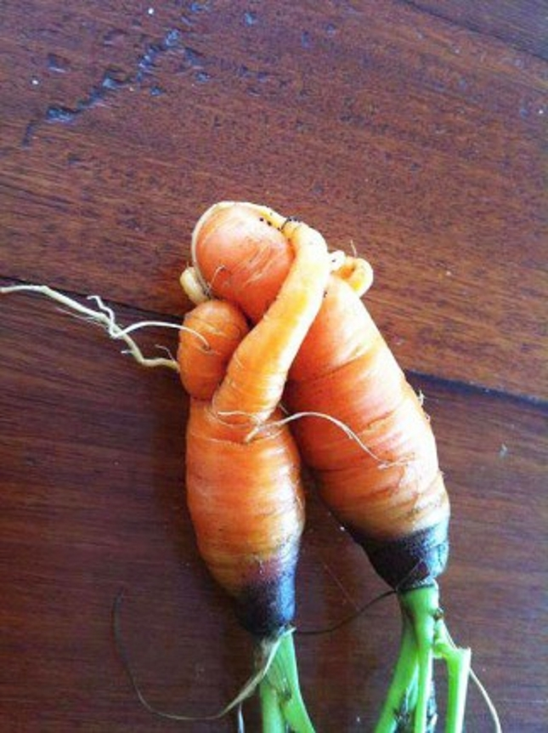

Slide 25
Narratives of human-machine encounter

Slide 26
Human loves artificial being
Human loses control over artificial being
Human- Machine-Narratives
premodern
Artificial being protects humans)
Man creates artificial being
Artificial being fulfills wishes

Slide 27
Pygmalion
Human loves artificial being
Human loses control over artificial being
Human- Machine-Narratives
premodern
Artificial being protects humans)
Man creates artificial being
Artificial being fulfills wishes

Slide 28
Pygmalion
Human loves artificial being
Human loses control over artificial being
Golem
Human- Machine-Narratives
premodern
Artificial being protects humans)
Automata of Hephaistos
Man creates artificial being
Artificial being fulfills wishes

Slide 29
Pygmalion
Human loves artificial being
Human loses control over artificial being
Golem
Human- Machine-Narratives
premodern
Artificial being protects humans)
Automata of Hephaistos
Man creates artificial being
Artificial being fulfills wishes
Wishing Well
Ghost in a bottle

Slide 30
Pygmalion
Human loves artificial being
Human loses control over artificial being
Golem
Human- Machine-Narratives
premodern
Artificial being protects humans)
Automata of Hephaistos
Man creates artificial being
Faust 2
Homunkulus
Artificial being fulfills wishes
Pygmalion
Wishing Well
Ghost in a bottle

Slide 31
Pygmalion
Pandorra`s Box
Frankenstein
Human loves artificial being
Human loses control over artificial being
Golem
Human- Machine-Narratives
premodern
Artificial being protects humans)
Automata of Hephaistos
Man creates artificial being
Faust 2
Homunkulus
Artificial being fulfills wishes
Pygmalion
Wishing Well
Ghost in a bottle

Slide 32
Human loves artificial being
Human loses control over artificial being
Human- Machine-Narratives
modern
Artificial being protects humans
Man creates artificial being
Artificial being fulfills wishes

Slide 33
Human loves artificial being
Human loses control over artificial being
Human- Machine-Narratives
modern
Artificial being protects humans
Man creates artificial being
Terminator 2
Film
Artificial being fulfills wishes
As teampartner

Slide 34
Her
Film
Du bist mein Mensch
Film
Human loves artificial being
Ex Machina
Film
Sandmann
Buch
Human loses control over artificial being
Human- Machine-Narratives
modern
Artificial being protects humans
Man creates artificial being
Terminator 2
Film
Artificial being fulfills wishes
As teampartner

Slide 35
Her
Film
Du bist mein Mensch
Film
2001 Space Odyssey
Film
RUR
Theater
Human loves artificial being
Ex Machina
Film
Sandmann
Buch
Matrix
Film
Human loses control over artificial being
Terminator 1
Film
Human- Machine-Narratives
modern
Artificial being protects humans
Man creates artificial being
Terminator 2
Film
Artificial being fulfills wishes
As teampartner

Slide 36
Her
Film
Du bist mein Mensch
Film
2001 Space Odyssey
Film
RUR
Theater
Human loves artificial being
Ex Machina
Film
Sandmann
Buch
Matrix
Film
Human loses control over artificial being
Terminator 1
Film
Human- Machine-Narratives
modern
Artificial being protects humans
Man creates artificial being
Terminator 2
Film
Artificial being fulfills wishes
As teampartner
Metropolis
Film
Ex Machina
Film

Slide 37
Her
Film
Du bist mein Mensch
Film
2001 Space Odyssey
Film
RUR
Theater
Human loves artificial being
Ex Machina
Film
Sandmann
Buch
Matrix
Film
Human loses control over artificial being
Terminator 1
Film
Human- Machine-Narratives
modern
Artificial being protects humans
Man creates artificial being
Terminator 2
Film
Artificial being fulfills wishes
As teampartner
Metropolis
Film
Ex Machina
Film
Data
Star Treck
R2D2
Star Wars
C-3PO
Star Wars

Slide 38
The Drama of Losing Control
Red lines we should not cross under any circumstances!
Max Tegmark

Slide 39
Never should we connect AI to the internet!
Red lines we should not cross under any circumstances!
Max Tegmark

Slide 40
Uuups, we already have!
Never should we connect AI to the internet!
Red lines we should not cross under any circumstances!
Max Tegmark

Slide 41
Uuups, we already have!
Never should we connect AI to the internet!
Red lines we should not cross under any circumstances!
Max Tegmark
Never should we give machines the chance to learn more about humans than we want them to learn.

Slide 42
Uuups, we already have!
Never should we connect AI to the internet!
Red lines we should not cross under any circumstances!
Max Tegmark
Uuups, we already have!
Never should we give machines the chance to learn more about humans than we want them to learn.

Slide 43
Uuups, we already have!
Never should we connect AI to the internet!
Red lines we should not cross under any circumstances!
Max Tegmark
Uuups, we already have!
Never should we give machines the opportunity to manipulate humans!
Never should we give machines the chance to learn more about humans than we want them to learn.

Slide 44
Uuups, we already have!
Never should we connect AI to the internet!
Red lines we should not cross under any circumstances!
Max Tegmark
Uuups, we already have!
Never should we give machines the opportunity to manipulate humans!
Never should we give machines the chance to learn more about humans than we want them to learn.
Uuups, we already have!

Slide 45
Uuups, we already have!
Never should we connect AI to the internet!
Never should we teach machines to write their own code.
Red lines we should not cross under any circumstances!
Max Tegmark
Uuups, we already have!
Never should we give machines the opportunity to manipulate humans!
Never should we give machines the chance to learn more about humans than we want them to learn.
Uuups, we already have!

Slide 46
Uuups, we already have!
Uuups, we already have!
Never should we connect AI to the internet!
Never should we teach machines to write their own code.
Red lines we should not cross under any circumstances!
Max Tegmark
Uuups, we already have!
Never should we give machines the opportunity to manipulate humans!
Never should we give machines the chance to learn more about humans than we want them to learn.
Uuups, we already have!

Slide 47
Groups of 3:
“How do I view AI?
Is it just a tool?
Do I see it as a technology?
A being?
How will this view affect my project?
”

Slide 48
GenAI
Piece of Art

Slide 49
Audience,
Spectator
Interface,
Mediator,
GenAI
Output
Interface,
Mediator

Slide 50
Systemic View on Art
The Art is in the Interaction
The Artist is the Orchestrator of this Interaction

Slide 51
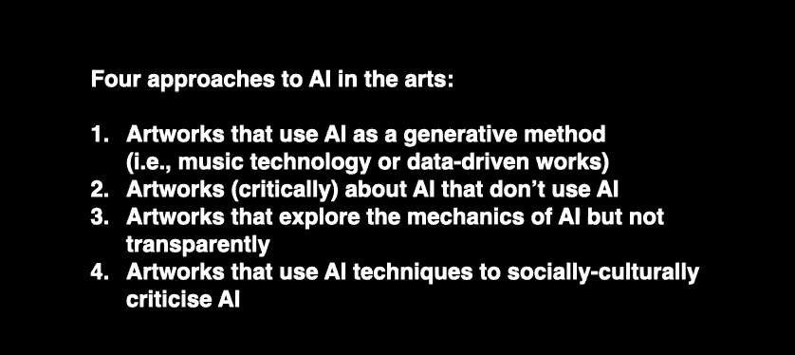
Chris Salter

Slide 52
Taking the perspective of
user/audience/guest/customer
Will I let the user interact with AI?
If yes, how?
If no, will I make the use of AI explicit?
How?

Slide 53


